Slide 1
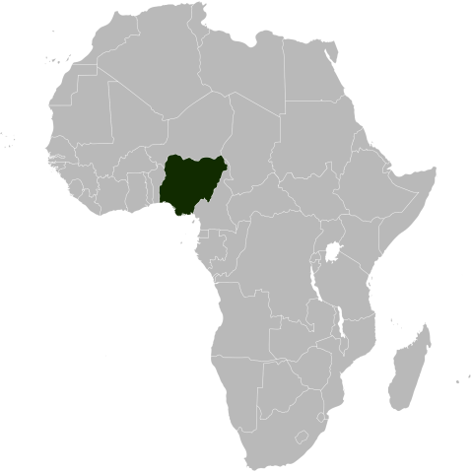
Nigeria
A Plan to Restore Confidence, Direction & Growth
Savannah Centre for Diplomacy, Democracy & Development – Abuja
His Highness Muhammad Sanusi II, Emir of Kano
2nd December 2016

Slide 2
Background & History
Why is this crisis different than the last one?
The years of “Africa Rising” were driven by two major factors, neither of which is still in existence today:
A dramatic rise in the purchasing power of raw commodities
A rapid increase in public sector borrowing, used to stimulate consumption
Absent these two factors, growth can only come through investment. Why?
For any given economy there are only three sources of growth:
Consumption
Investment
(Net) Exports
Public consumption cannot grow without increasing revenues or leverage
Private consumption cannot grow without rising wages or tax cuts
Oil exports cannot grow without regulatory certainty and/or price rises
This leaves investment as the only viable option for growth
2

Slide 3
Two Pillars of “Africa Rising”
1st pillar – commodity exports
The terms of trade – in other words, the purchasing power of commodity exports – were a big part of the Africa Rising narrative, and the lost decades before it.
In 2002, it would have taken 19 barrels of oil to import a single Sanyo flip phone, at that time a mid-range phone. By 2008, a phone from the same range could be imported with less than one barrel of oil.
Yet this process did not benefit all economies evenly. Many of the East African economies saw no material change in their terms of trade but still grew strongly.
Source: World Bank Development Indicators
3

Slide 4
Two Pillars of “Africa Rising”
2nd pillar – rising debt
Source: IMF World Economic Outlook (WEO)
Heading into the Global Financial Crisis (GFC) Sovereign balance sheets had been cleaned up by Paris Club and HIPC debt relief initiatives
When the crisis hit, there was scope for both monetary and fiscal stimulus. New debts were raised on growing local currency markets.
This maintained growth at artificially high levels and contributed to a (mistaken) belief that Africa had “decoupled”.
The decoupling myth was only true to the extent that governments could keep taking on more debts. Today, balance sheets are much more stretched.
4

Slide 5
Two Pillars of “Africa Rising”
Where did all this debt go?
New borrowings were recycled into higher recurrent expenditure, helping to sustain and prolong the consumption boom which had been started by rising commodity prices.
For many countries, the growth in public wage bills accelerated precisely as the commodity revenues were getting hit by the crisis.
In Nigeria, the public sector wage bill went up from N443bn in 2005 to N1,659bn in 2012 , driven by a 53% increase in civil servants’ wages in 2010.
In Ghana, the public sector wage expended by a factor of 10x in real terms in 10 years. Then, the hangover came…
Source: Haver, National central banks
5

Slide 6
The New Normal: 2-Speed Africa
No longer one tide lifting all boats
With the two major pillars of “Africa Rising” no longer in play, what will drive growth going forward?
Instead of one “Africa Rising” we will most likely see a 2-speed continent where some economies growth at twice the regional average, and others are basically stagnant.
In fact, the non-commodity group of African countries is expected to be the fastest growing in the world, even ahead of Asia.
What are the features of these economies, and what are they doing so differently?
Source: IMF WEO
6

Slide 7
The New Normal: 2-Speed Africa
In an era of lower commodity prices, what still works?
The common characteristics of the fast-growing group are:
Investment-driven instead of commodity-dependent;
Capital recipients rather than capital exporters
Coherently-planned rather than free-for-all capitalist
The experience of East Africa shows that the investment-driven model can deliver high, relatively inclusive growth.
This kind of growth requires neither commodity revenues nor unsustainable levels of public debt. So why is this model not accessible to Nigeria?
Source: World Development Indicators
7

Slide 8
Problems With the Current Policy Agenda
Why must Nigeria be Africa’s laggard rather than its leader?
No one can deny that the Buhari Administration inherited serious problems. But are its current policies the right ones to fix these problems?
If we accept the conclusion of the first part of the presentation, namely that:
The government balance sheet is stretched;
And investment is the key to growth…
Why has the Federal Government pinned its hope of a recovery on a strategy of:
Massive fiscal expansion;
And an FX policy that deters investment?
8

Slide 9
Problems With the Current Policy Agenda
Part I: The limits of fiscal stimulus
Federal Government spending accounts for just 5.7% of GDP, and one quarter of this is for debt service alone. The role of government spending in the broader economy is minor.
This is particularly true of public capex: while the economy has quadrupled in nominal terms since 2005, and the population has grown by over 40 million, capex has barely changed.
There is much talk about raising non-oil revenues, but the tough measures (like tax increases) are not being taken.
The best ever out-turn for non-oil revenues was N779bn in 2014. This would be enough to fund 13% of the 2016 budget.
Source: Budget Office of the Federation
9

Slide 10
Problems With the Current Policy Agenda
Part I: The limits of fiscal stimulus (cont’d)
Even if the government managed to increase revenue significantly, it would still need re-prioritise spending towards capex.
Across all 3 levels of government, Nigeria collected just US$117 per capita in 2015, and invested US$17. Kenya, with half of Nigeria’s level of wealth on paper, collected almost twice as much in taxes and invested over 7x as much.
If Nigeria is going to adopt an investment-driven model, it cannot rely on the public sector alone.
 |  | GDP/Capita | Tax Revenues/Capita | Development Spending/Capita
 |  | US$ (nominal) | US$ (nominal) | US$ (nominal)
 | Angola | 4,100 | 1,012 | 276
 | Botswana | 6,041 | 2,702 | 684
 | Côte d'Ivoire | 1,315 | 211 | 89
 | Egypt | 3,740 | 438 | 89
 | Ethiopia | 687 | 101 | 82
 | Ghana | 1,340 | 239 | 58
 | Kenya | 1,388 | 232 | 129
 | Mauritius | 9,218 | 1,738 | 194
 | Morocco | 3,079 | 559 | 169
 | Nigeria | 2,743 | 117 | 17
 | Tanzania | 942 | 119 | 49
 | Uganda | 620 | 85 | 43
 | Zambia | 1,350 | 172 | 79
Source: IMF WEO, National central banks, Haver
10

Slide 11
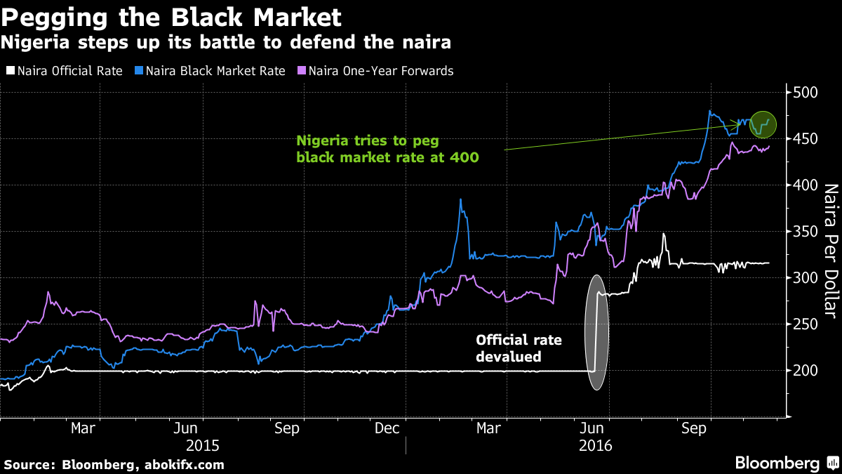
Problems With the Current Policy Agenda
Part II: the FX regime
Nigeria introduced bold FX reforms in the summer of 2016, and then completely failed to implement them. The gap between design and implementation has ruined credibility.
After announcing a (managed) flotation of the naira in June, the CBN instead implemented a hard peg (at a lower level).
The FX market is now split into 4 different segments: the CBN rate (N305/US$), FMDQ (N315/US$, but not printed since 28 Nov), NIFEX (N315/US$) and the black market rate (N480/US$).
The black market rate is the only segment with any real price discovery, and hence perceptions of “fair value” are high-jacked by where this market trades.
Source: Bloomberg, AbokiFX
11

Slide 12
Problems With the Current Policy Agenda
Part II: the FX regime (cont’d)
“Fair value” of the naira is not the issue. The current crisis of confidence in NGN/US$ comes from a lack of transparency and functionality.
On a trade and inflation weighted basis, the naira has gone from one of the most over-valued currencies in the world to one that is now under valued.
This suggest that Nigeria is comparatively cheap – and indeed much cheaper than many countries with a long history of attracting capital from abroad.
Source: Bruegel, Bloomberg
12

Slide 13
Problems With the Current Policy Mix
Part II: the FX regime (cont’d)
Interest rates are not the issue. In tandem with its currency reforms, the CBN has restored positive real interest rates.
The changes have been dramatic: as recently as January, real interest rates were deeply negative in Nigeria.
However, local currency returns are now among the most attractive in Africa, as well as the wider frontier universe.
Under a more credible policy environment, this would help draw in capital from abroad, and incentivise locals with savings to keep their money onshore.
Source: Haver, Bloomberg, Central banks
13

Slide 14
Problems With the Current Policy Mix
Part II: the FX regime (cont’d)
Asset prices are not the issue. If anything they are exceeding attractive. Both P/B and P/E ratios are trading near record lows relative to their own 5-year range.
At a time when Global (and many EM) stocks have rarely been more expensive, Nigerian stocks almost never been so cheap.
The picture looks particularly out of sync for banks, where the sector is trading on a 1-year forward P/B ratio 0.5x while sector-wide ROEs for H1 2016 were 16.5%.
Why are the policies that keep things this way being allowed to continue?
Source: Bloomberg
14

Slide 15
How Bad Policies Are Perpetuated
The CBN-FGN Nexus
The CBN-FGN relationship is no longer independent.
In fact one could argue their relationship has become unhealthy. CBN claims on the FGN now top N4.7trn – equal to almost 50% of the FGN’s total domestic debts.
This is a clear violation of the Central Bank Act of 2007 (Section 38.2) which caps advances to the FGN at 5% of last year’s revenues. The overdrafts alone are equal to more than 10x that prescribed limit, and are growing every month.
Has the CBN become the government’s lender of last – or first – resort?
Source: Central Bank of Nigeria
15

Slide 16
The Deepening Macro Risks
How policy gridlock is spilling over into the economy
Source: CBN, NBS
Without the right policies to encourage investment – which necessarily begin with the FX regime – growth is unlikely to recover and may even continue to fall.
In the absence of economic growth, the banking sector will find it hard to grow out of its asset quality issues, with NPLs already high and still rising.
Rising NPLs continue to erode banks’ capital, yet new capital is very difficult to raise when the FX regime deters all investment into Nigeria.
The FGN and CBN lack the resources for AMCON 2.0, and through their policies are pushing the cost of resolving the banking crisis onto the household sector.
16

Slide 17
The Deepening Macro Risks
Following in Egypt’s footstep’s?
As a strategically important country in the geopolitics of the Middle East, Egypt was able to resist market forces for years thanks to GCC support.
But having exhausted all sources of concessional financing, it is now in the throes of a painful fiscal and macro adjustment, imposed by the IMF.
Revenues will need to be raised by +5pp of GDP (+50% in absolute terms); a new VAT (of 13%) is being imposed; central bank financing (historically 50% of the budget deficit) will likely be cut off; and new concessional loans will be subject to passing quarterly IMF reviews.
Is there where Nigeria is headed?
+5.0 percentage
points/GDP
Source: IMF
17

Slide 18
The Deepening Macro Risks
Nigeria’s wasted opportunity
Nigeria’s approach to managing its economic crisis is severely misguided:
Fiscal policy is given all the attention but its potential impact is small
FX policy is closed subject, yet it holds the (only) key to growth
To understand the missed opportunity this represents, consider the example of Kenya:
It has concessional debt equal to 38% of GDP (vs 2% in Nigeria) and has attracted investment inflows from abroad of 8-10% of GDP (vs 1-3% in Nigeria) over the past several years
Scaled to Nigerian proportions, this would represent annual investment inflows of nearly US$40bn and an external debt carrying capacity of over US$150bn
The reality is that in H1 2016, Nigeria has managed to raise just US$543mn in external concessional debt, and has received total investment inflows of US$663mn
If Kenya – an economy 15% our size, with an exchange rate trading more than 40% above its fair value – can raise more in concessional funding and inflows than us (in absolute terms), can we honestly say that our policies are working?
18

Slide 19
Solutions For 2016 and Beyond
Short-term fixes
Nigeria’s should gear its policies towards attracting investment:
Implement the June 2016 FX reforms, which were designed to unite the market in single, transparent rate, not to create four new ones.
Focus on reducing FGN debt service through greater concessional borrowing rather than increasing its spending through CBN financing
The bottom line:
Until Nigeria signals a clear change in policy it will be difficult for it to restore credibility;
Until credibility is restored, it will be difficult for it to attract investment (both from at home and abroad);
Until investment picks up, it will be difficult for Nigeria to return to growth.
19

Slide 20
Solutions For 2016 and Beyond
Medium-term challenges, Part I: Power
Nigeria’s power sector reforms have stalled, and the sector is in danger of collapse unless urgent action is taken. What can the Federal and State governments do?
(i) Petition for a specific debt raising programme to address unpaid arrears. Until this happens no new investment can take place.
(ii) Raise public awareness about the necessity of cost-reflective tariffs, including the hike in 2016.
(iii) Ensure that DISCO owners make the stipulated investment in metering.
Source: National Bureau of Statistics
20
Notes:
The problems here are almost intractable, and I’m trying to focus on what planning commissioners and lawmakers can actually do. Broadly, I think 4 things are required (only some of which planning commissioners can influence):
Stop the accumulation of arrears to JV partners. O&G companies are already struggling with low oil price environment; if the NNPC keeps reneging on their share of the capex, there will be no capex, production will fall, and federation revenues will decline, impairing the government's ability to support the power sector.
Raise fresh capital to pay off arrears to Gencos. These are N235bn and building. The higher the tariffs go (as they are bound to do) the more quickly they will build. I’ve read estimates that the rate of accumulation will likely be N30bn/month post the deval. This is more than NBET can handle with current levels of capitalisation. And until these backlogs are paid, no one is going to invest in new generation capacity.
Force Disco owners to make stipulated investments in metering. What I’m told is that many disco owners have failed to honour their terms of the agreement, both in investing in metering and upgrading the old infrastructure. Until this failure in the value chain is addressed, collection rates will never be good enough to achieve cost recovery, and the government/NBET will always be on the hook for the shortfall.
Resolve gas supply issues. This applies especially to the 10 IPPs under the NDPHC – the infrastructure to get the gas in is still not there – it also raises lots of security/local community issues.

Slide 21
Solutions For 2016 & Beyond
Medium-term challenges, Part II: Industry
Without greater power generation, Nigeria’s import-substitution initiatives are meaningless
Exporters like China offer cheap credit, but in return demand access to local goods markets. Developing local manufacturing capacity is counter to their interests.
With a couple exceptions (narrow commodity stories like RepCon & Angola) most African countries are net importers from China, and produce few finished goods of their own.
The solution is not FX swaps with China – which are in practice just a subsidy for Chinese exporters – but direct investment into local manufacturing capacity.
Source: IMF WEO, DOTS
21

Slide 22
Summary Points & Conclusion
What lessons can we take away?
The years of “Africa Rising” where one tide could lift all boats are behind us: the commodity cycle has turned, and government balance sheets are stretched.
Sustainable, inclusive growth now depends on investment – and in Nigeria’s case, policy credibility will first need to be restored.
The role that government can play in this process is defined by: (a) implementing the FX policy it already has; (b) creating the conditions for local manufacturing to develop
More specifically, it can:
Allow price discovery to occur in the foreign exchange market
Close the gap between FX policy design and implementation
Shift the focus of fiscal policy towards reducing debt-servicing costs
Firmly and unequivocally eliminate fuel subsidies
Raise more concessional funding from abroad
Capitalise NBET, so that arrears can be cleared
Protect infant industry, specifically labour-intensive manufacturing
22

Slide 23
Thank You
Q & A
23

