Slide 1
Pension Asset Risk Management in the face of uncertainties

Slide 2
Executive Summary
Assets Growth
Global pension assets have been on the rise across the world despite several challenges. Nigeria pension assets grew by 18% in 2019.
Defined contribution (DC) is settling in as the dominant global pension model. DC assets outstripped DB assets across the aggregate of the six largest pension markets in 2019 in historic first. This has implications on the quality of lives of contributors at retirement as the retirement risks( investment, market, longevity risks, etc.) have been transferred from the corporate and government sectors to the contributors.
Pension assets are exposed to different risk across the world. These risks have dire consequences on the retirement income of contributors .In Nigeria, whilst the pension assets have grown by c. 21% annually in the past decade, the growth in the value of the assets when converted to USD has only been about 11% over the same period.
All stakeholders in the Financial sector industry have a pivotal role to play in monitoring the current and emerging risks with a view to mitigitating the risks. This is important in order to ensure that contributors maintain a reasonable standard of living at retirement.
Changing Pension model
.
Risk
Looking Forward

Slide 3
Industry Snapshot
The Nigerian pension industry is one of the fastest growing sectors in the Nigerian financial services industry
A fast-growing private sector-led industry
(CAGR of 23.5% between 2007 & 2019)
…backed by strong regulation and an active regulator
The total pension contributions received in the industry from inception was almost equally split between the private and public sectors at the end of Q3 2019
The industry is governed by the provisions of the Pension Reform Act 2014 and National Pension Commission (“PenCom”), the regulator, is widely regarded as one of the most efficient regulators in the financial services industry
Nigerian Pension Industry
…with huge potential for growth
…and a race to the top among players
As at June 2020, only 11.3% of the Nigerian labor force had opened retirement savings accounts (RSAs) while pension assets stands at less than 10% of GDP
The top three PFAs accounted for circa 54.0% of industry FUM as at September 2019. The industry has witnessed a number of Mergers and Acquisition in recent years
Key statistics (2020)
NGN11.1 trillion
9.04m
32
Funds Under Management
Subscribers
Pension Operators

Slide 4
Global DC assets are on the rise
Contributors will become increasingly exposed to financial markets as a result of the transition from DB to DC which will therefore expose retirement income to greater variability in the future.
DC assets globally are growing faster than DB( 10–yr. CAGR 8.4% pa vs 4.8%pa).The growth has been driven by increased member coverage and higher contributions. Most retirees might not have enough funds to maintain a decent standard of living as retirement risk has been transferred to them.
Source: Global Pension Assets Study by Thinking ahead institute

Slide 5
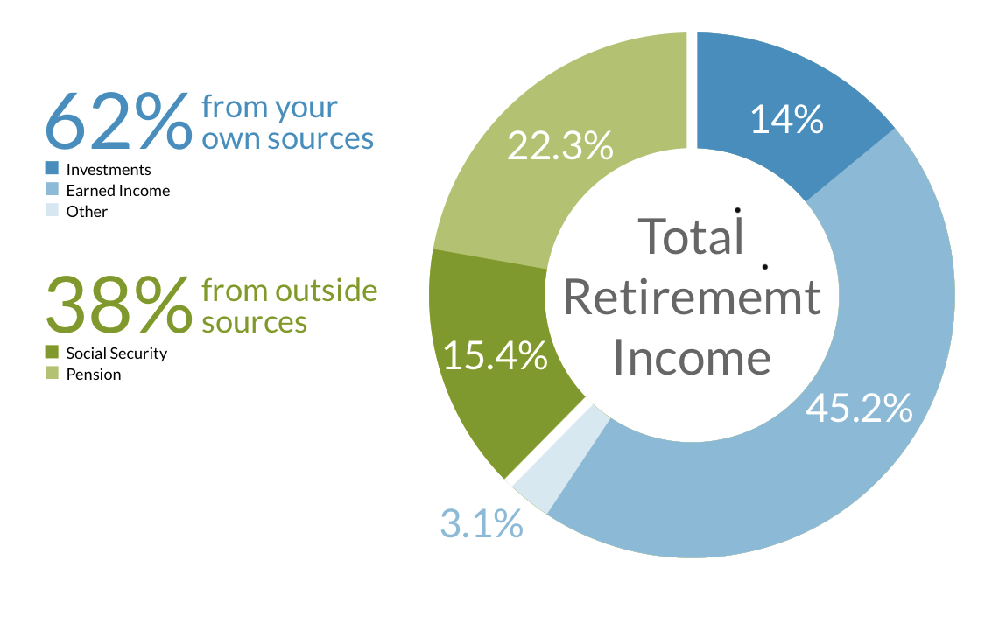
Who bears retirement risks?
Source: US Social Security Administration

Slide 6
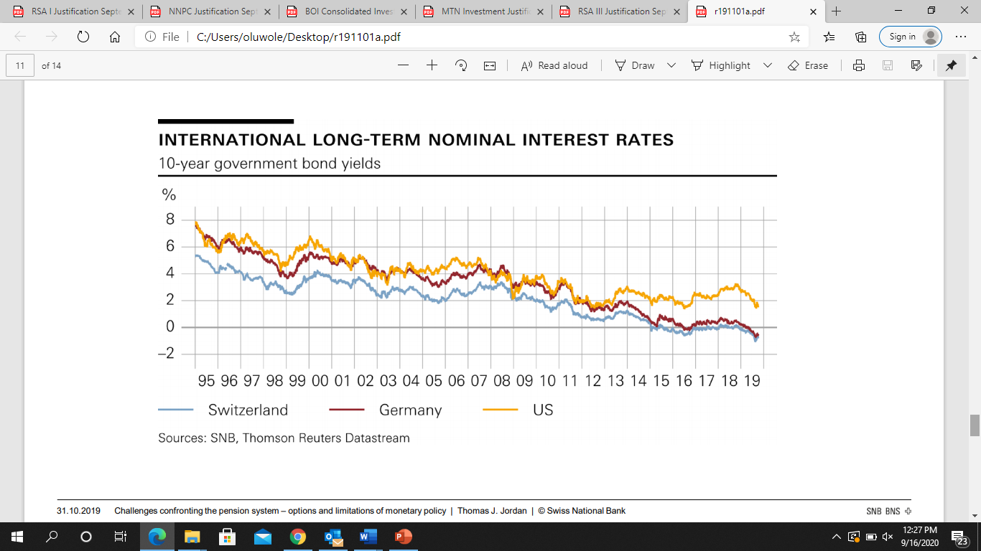
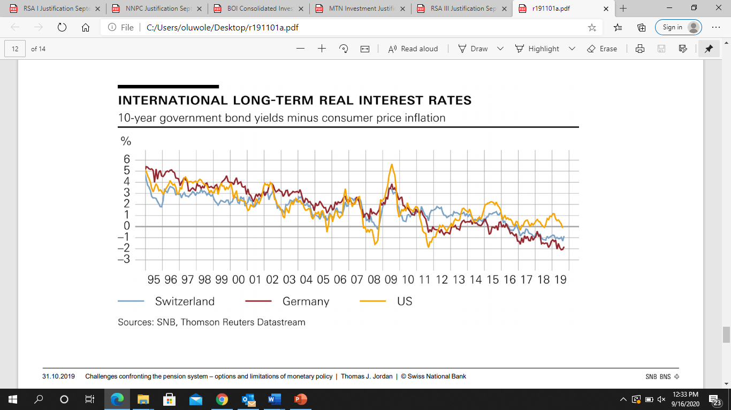
….Global trends….
Low interest rate environment – increasingly difficult to meet benefit commitments
  Negative interest rates (for monetary expansion during periods of financial crisis) and its effect on long term rates
Notes:
Low interest rate environment - The first challenge that you as pension fund managers have faced for some considerable time now is the persistently low level of interest rates. These low rates are prevalent in all the major currency areas. For the pension funds, which traditionally have large holdings of interest-bearing investments, this situation naturally means lower investment income. This makes it more difficult for the pension funds to meet their existing benefit commitments. The measures taken by the central banks to combat the financial and economic crisis – low policy rates, forward guidance on the expected course of short-term interest rates, and securities purchases – have undoubtedly increased downward pressure on the general level of interest rates in the short and medium term.

Slide 7
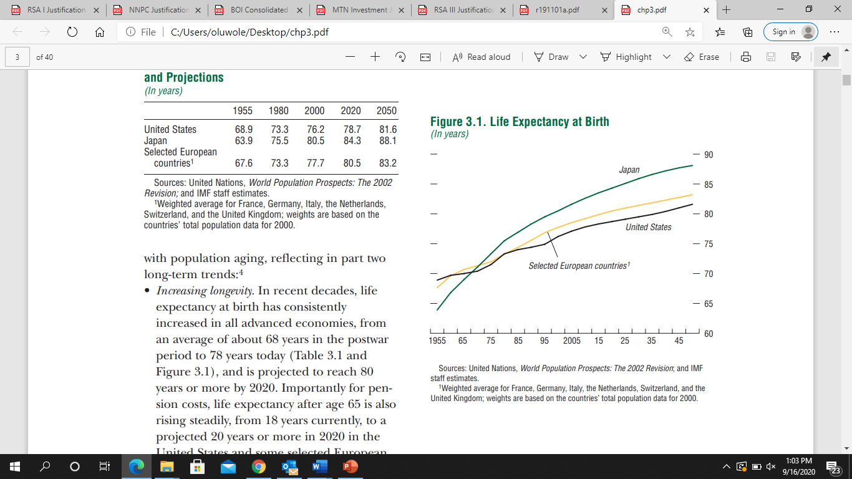
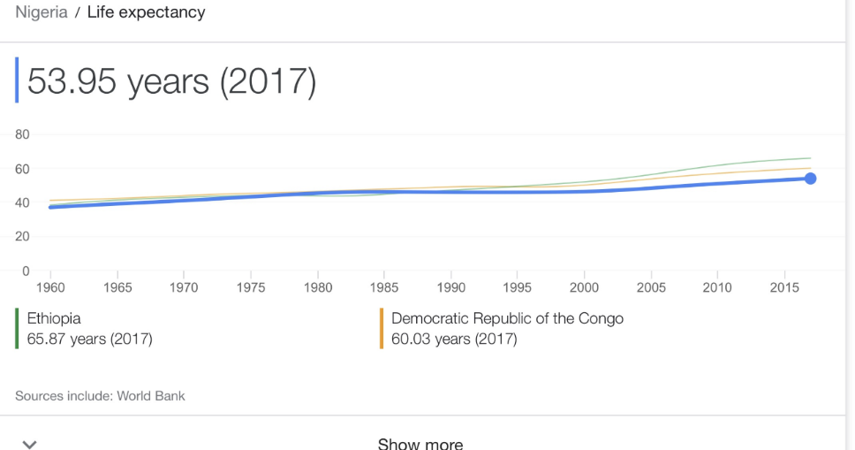
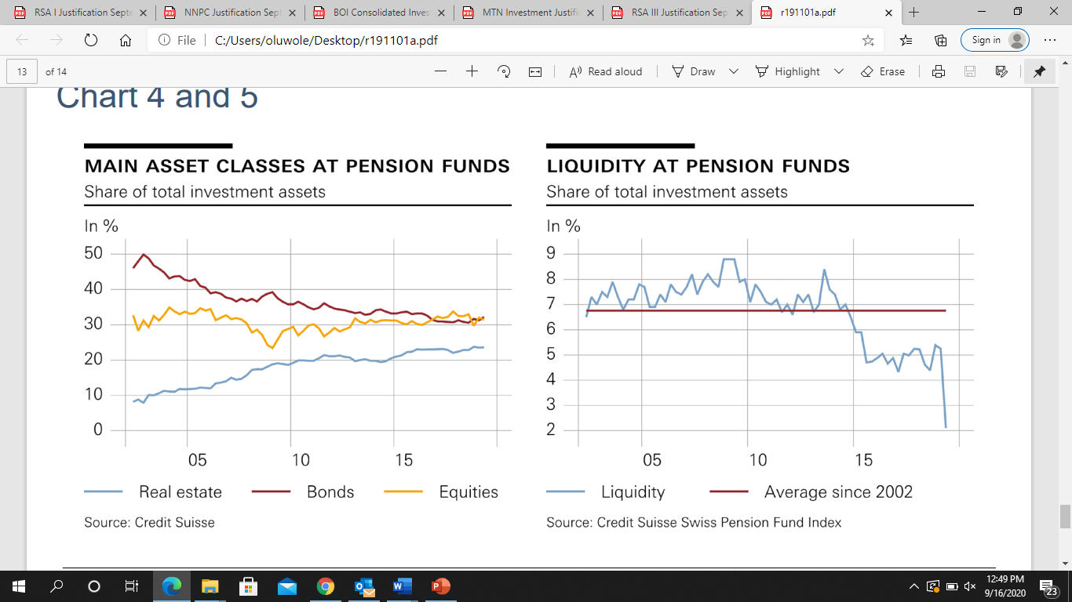
….Global trends….Continued
Longer life expectancy – a success story and challenge
Pension funds – reacting with moderation and flexibility
Notes:
Rising life expectancy is not only influencing the propensity to save but is also having a direct impact on the pension funds. Given an unchanged retirement age, it steadily lengthens the average duration of pension payments. This in turn results in higher payments and extra strain on the pension funds.
Reacting with moderation and flexibility. On the investment side, the exposure to fixed-income instruments has been reduced – given the persistently low interest rates – in favour of equities and real estate. Furthermore, the pension funds have again become more active abroad, and are keeping their liquid assets to a minimum. liquidity as a share of total investment assets is currently at a historic low

Slide 8
Bringing it home ….. Risks we face -Macroeconomic Risk
Macro Risk - movements in macro economic variables that can lead to a reduction in pension assets :
GDP
Weak economic growth has led to reduced spending and investment by government and the private sector.
Inflation
Sticky, averaged c.12% over the last 10-years. Further exacerbated by negative real interest rates
Unemployment rate
Persistently high unemployment (c.25%) rate means reduced contribution and increase in early withdrawal requests
Currency
Multiple devaluations have been experienced over the last 15 years. Naira has lost circa 65% of its value in the last 15years
ARM Pensions © 2020

Slide 9
Other risks
Political/Policy Risk
Operational Risk
Legal Risk
Cannibalization of pension assets(armed forces, etc.)
Policy adjustments that place pension assets at risk (early payouts, larger lump payments etc.)
Lower industry profitability might limit operator investments
Dearth of talent
Recent legal challenges to aspects of the CPS
Investment Risk
Longevity Risk
Emerging Risk
Lower investments returns
Limited investment outlets – Pension assets have grown faster than its available investable asset class
Asset-Liability Mismatch-Need for more assets with longer maturities to enhance Asset –Liability matching
People are living longer, better healthcare
Minimum Pension Guarantee - DC scheme Vs DB scheme
Cybersecurity
Health crisis(Pandemic) e risk is that it could potentially convert a DC scheme to be a quasi DB scheme in the long run

Slide 10
How to mitigate some of the risks
Market Development
  Increased collaboration among different stakeholders across the investment value chain (Investment bankers, brokers, regulators, pension funds) to create new investment products (Inflation indexed bonds, ETFs, dollar linked products, etc.)
  Market development work with stakeholders to improve the supply and quality of alternative assets e.g. infrastructure funds, inflation linked instruments, PE funds, REITs, 40-50year Bonds Instruments, etc.
  Engagement with all regulators (ability to invest a portion of pension assets offshore)
Increased advocacy for improvement in corporate governance will lead to increased supply of credit worthy corporates
Stakeholders must also develop adequate business continuity plan, contingent plans and resilient operations for long-run benefit of the industry
Improve industry engagement and skillset across the industry (operators, regulators and the general public) through trainings and workshops
Adapting the parameters to economic and actuarial realities is an ongoing task of both pension fund managers and political bodies – in normal as well as exceptional times. (i.e. mortality rate, payout, retirement age ,etc.)
Increased awareness and sensitization of contributors by stakeholders on the need to embrace early financial planning(supplement RSAs with voluntary contributions, other investment assets,etc.) ALM
ARM © 2020

Slide 11
Thank you
ARM Pensions © 2020

